Slide 1
PYTHON WORKSHOP

Slide 2
ELECTRICITY BILL CALCULATOR

Slide 3
TEAM NAME
KITE DEVELOPERS

Slide 4
TEAM NUMBER: 23
Guided By:
ACADEMIC MENTOR:
Prof. Mr. S. Rajasekaran

Slide 5
TEAM MEMBERS
MANOJ. S
MITHUN SANTHOSH. Y
NANDHINI.M

Slide 6
MAIN OBJECTIVE:
To develop a mini project on “Electricity Bill Calculator” using Python programming and GUI.

Slide 7
ELECTRICITY
DOMESTIC
COMMERCIAL
INDUSTRY

Slide 8
ABSTRACT:
It is an GUI Computer application which is used to help the user to calculate their Electricity payment bills according to their consumption with respect to Tariff rates which is given by TNEB. It has three tariff that includes Domestic, Commercial and Industry. User can enter their consumption in units and can select their tariff type and computation done based on the tariff category which is already specified.

Slide 9
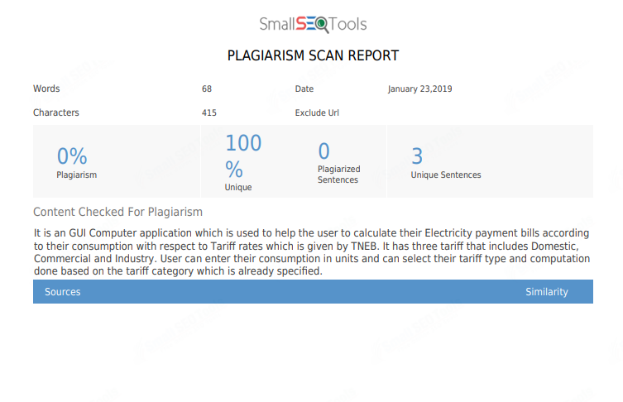

Slide 10
Model architecture:
start
user
home
Options for locality
Enter units
Calculation
Charges
Stop

Slide 11
Modules and requirements:
Welcome Module
Presentation Module
Calculation Module
Outcome module

Slide 12
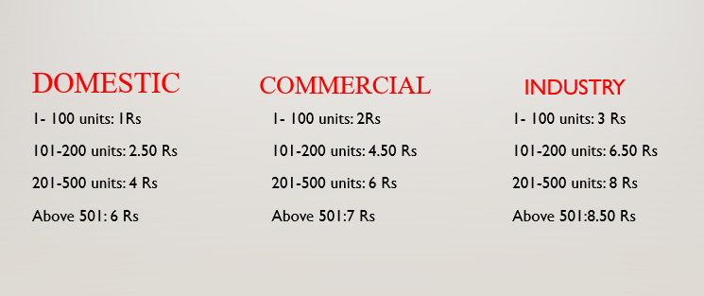
PRESENTATION MODULE

Slide 13
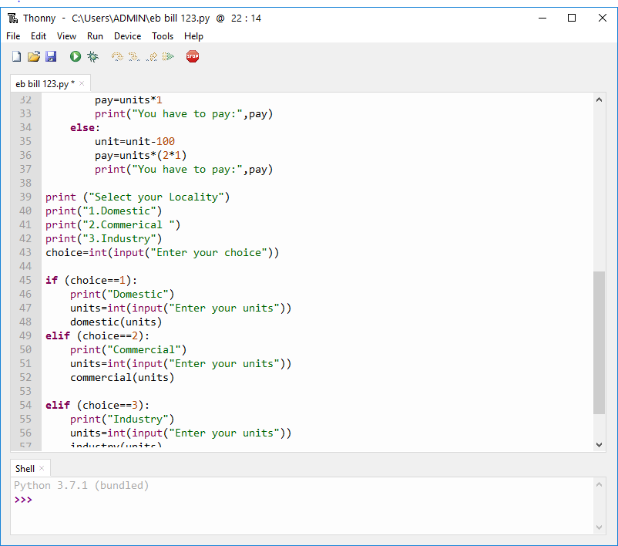
Sample code:

Slide 14
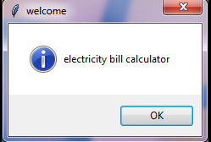
USER INTERFACE

Slide 15
MERITS:
By using this application user can calculate their EB charges without any external help

Slide 16
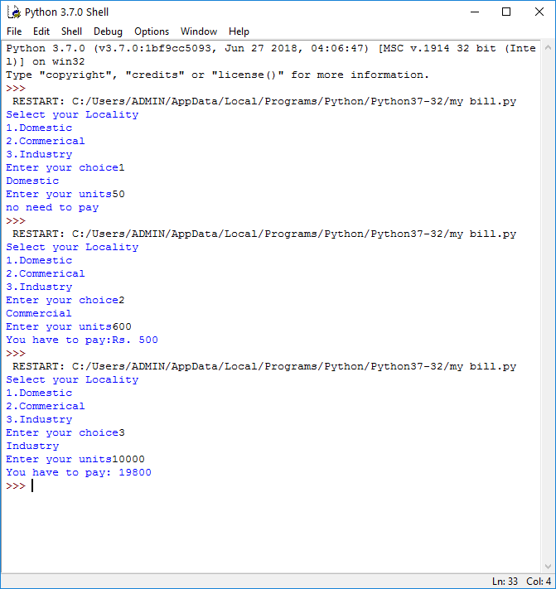
Outcomes:

Slide 17
Conclusion:
The Electricity bill calculator has been developed in python using Tkinter gui and deployed successfully.

Slide 18
References:
https://www.tangedco.gov.in/linkpdf/ONE_PAGE_STATEMENT.pdf
https://realpython.com/tutorials/advanced/
https://tkdocs.com/tutorial/install.html
https://likegeeks.com/python-gui-examples-tkinter-tutorial/#Adding-a-button-widget

Slide 19


Slide 20


